Slide 1


Public Sentiment Analysis on USAID After Trump’s Withdrawal
Team members :
Tracy Otieno, Stephen Muligwa, Boniface ,
Julius Wakahaba ,Dorothy Awino
Notes:
Links:
https://www.pexels.com/photo/people-near-table-3184639/

Slide 2
BUSINESS UNDERSTANDING
Problem Statement
Discussions about the impact of the USAID funding withdrawal are common on social media sites like Reddit, where users share a range of viewpoints. These conversations are still unstructured, though, and challenging to do large-scale analysis
Solutions
Sentiment analysis provides a more accurate understanding of the public sentiment
Stakeholders
Policymakers
NGOs
Stakeholders
Notes:
Links:
https://www.pexels.com/photo/photo-of-people-sitting-near-wooden-table-3183190/

Slide 3


PROJECT OVERVIEW
Project objective
Analyze public sentiment on USAID after Trump’s withdrawal. Extract key discussion themes from Reddit posts. Compare sentiment across platforms (if other data sources are added later). Build a chatbot for interactive sentiment queries.
Project Goals
This research aims to use Natural Language Processing (NLP) to examine Reddit comments about USAID and identify sentiment patterns and important subjects.
Business Impact:
Offer insights into the efficacy of policies and areas of concern. Assist NGOs and policymakers in understanding public opinion about USAID. Help academics, analysts, and journalists monitor patterns in discourse.
Notes:
Links:
https://www.pexels.com/photo/photo-of-people-near-computers-3183159/

Slide 4

DATA UNDERSTANDING
1)Reddit CSV Dataset
Entries - 1299
Columns- 15
Dataset Overview: The dataset, sourced from Reddit, captures public sentiment on USAID’s funding decisions, policies, and overall impact.
2)US foreign aid csv
Entries - 950543
Columns - 48
Dataset Overview:
The dataset sourced from Kaggle , captures the history of USAID functions before the withdrawal
Notes:
Links:
https://www.pexels.com/photo/business-businessman-contemporary-corporate-532220/

Slide 5
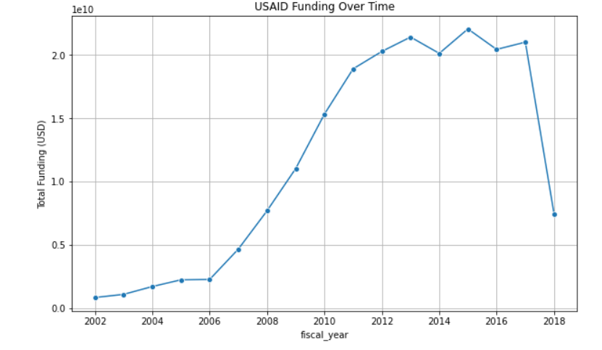


EXPLORATORY DATA ANALYSIS
Data set – Kaggle CSV file
The graph shows USAID funding over time, with a steady rise from 2000 to 2010, peaking between 2010 and 2016. A sharp decline occurs after 2016, aligning with Trump’s withdrawal of USAID funding. This drop marks a key policy shift, setting the stage for public sentiment analysis in the presentation.

Slide 6
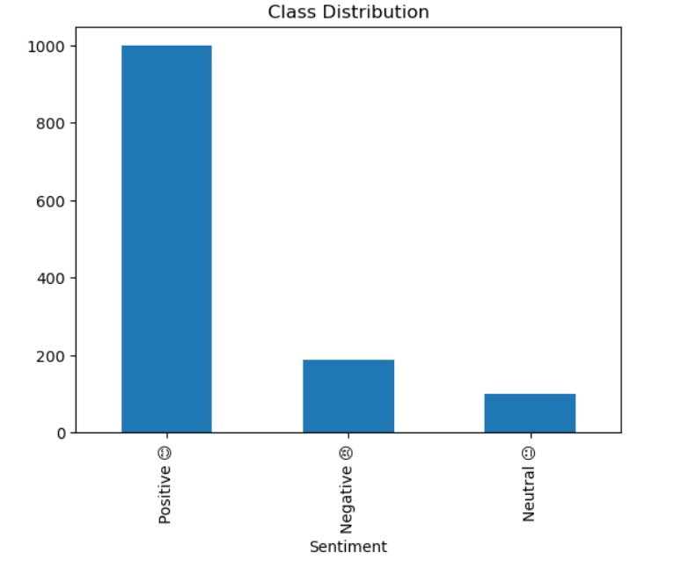
EXPLORATORY DATA ANALYSIS
Dataset- Reddit Csv File
This bar chart titled "Class Distribution" displays the distribution of sentiment classes: Positive, Negative, and Neutral.
The x-axis represents the Sentiment categories, while the y-axis shows the frequency count.
The Positive class has the highest frequency, with around 1000 instances, followed by the Negative class with approximately 200 instances, and the Neutral class with the lowest count, close to 100 instances.
79%
68%
46%
37%

Slide 7
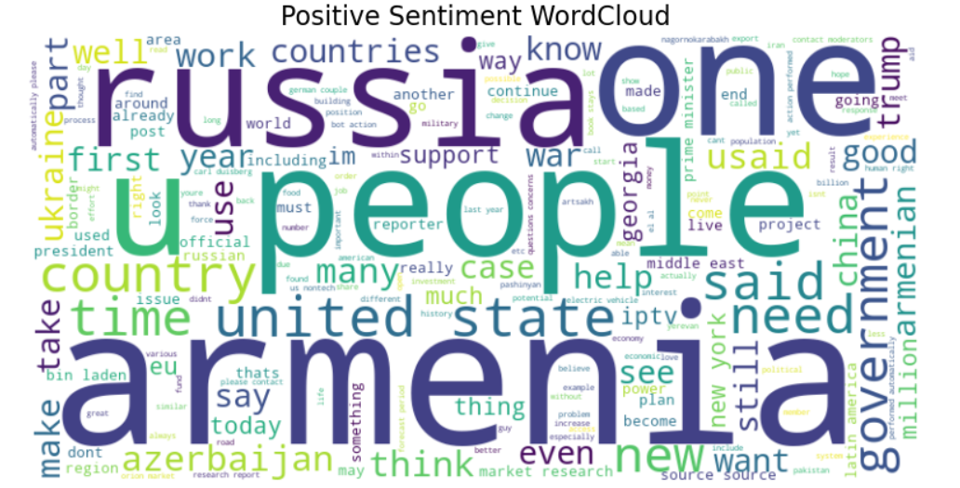
FREQUENCY OF WORDS
1)Positive Sentiment wordload
Main Themes: Words like Amenia, Russia, people and united states dominate the word cloud, suggesting that these topics were mentioned positively
Key Observations: Positive contributions by USAID or international efforts involving countries like Armenia and Russia. Positive sentiment reflects optimism around government initiatives or partnerships.

Slide 8
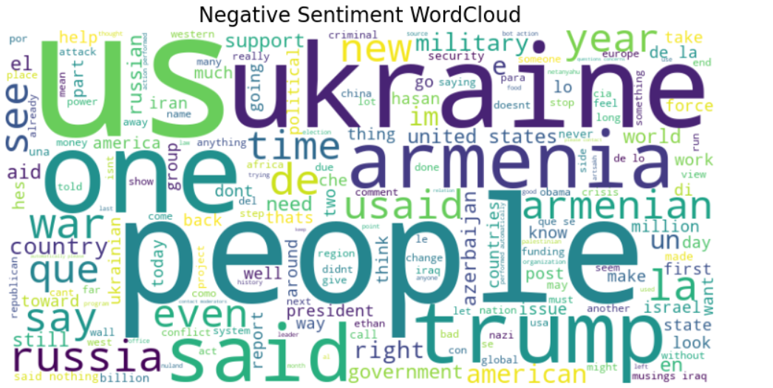
2) Negative Sentiment WordCloud
Main Themes: Words like Ukraine, US, Russia, Trump, people, and war are prominent, indicating a focus on conflict, dissatisfaction, or controversy.
Key Observations: Negative discussions center on USAID's involvement in contentious regions, war-related topics, and public criticism of specific policies. Terms like Trump and military suggest negative views on leadership decisions and USAID withdrawal.

Slide 9
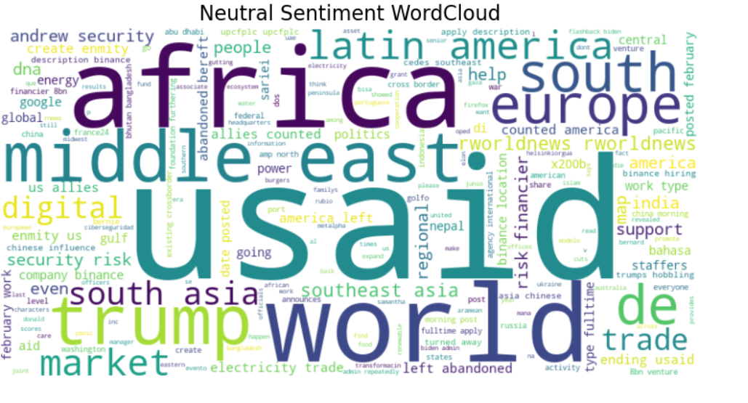
3) Neutral Sentiment WordCloud
Main Themes: Words like world, USAID, Africa, and Middle East appear frequently, suggesting that neutral discussions revolve around general information or broad topics.
Key Observations: Neutral sentiment represents factual reporting or balanced discussions about USAID’s role in various regions and sectors. Topics such as trade, digital, and energy hint at broader global or economic implications.

Slide 10
MODELING
LSTM Model
Metrics: 85% Accuracy | 84% F1-Score | 94% AUC…
Strengths:
Captures deep text dependencies (ideal for sentiment analysis)
High class discrimination (94% AUC)
Balanced precision and recall (84% F1-Score)
Weaknesses:
High resource and training time requirements
Risk of overfitting with deeper layers
CNN Model
Metrics: 85% accuracy, F1-Score: 84%, AUC: 94%.
Strengths:
Efficient feature extraction with faster training
Suitable for shorter, high-frequency text patterns
Weaknesses:
Limited in capturing long-range text dependencies
Conclusion
Why Choose CNN?
Faster and more resource-efficient, allowing for quicker model iterations and deployment, while maintaining strong performance metrics. Ideal for balancing accuracy and computational speed.
Notes:
Links:
https://www.pexels.com/photo/apple-laptop-notebook-office-39284/
https://www.pexels.com/photo/two-imac-s-with-keyboard-and-phones-on-desk-326503/
https://www.pexels.com/photo/photo-of-imac-near-macbook-1029757/

Slide 11
RECOMMENDATIONS
For Policymakers: Use insights to refine communication strategies, particularly in regions or themes where sentiment is negative.
For NGOs & Stakeholders: Highlight positive sentiment areas as opportunities for partnerships or advocacy campaigns.
Predictive Analysis: Develop a predictive model to forecast public sentiment in response to proposed policy changes or new initiatives by USAID.

Slide 12
THANK YOU
Names | Github UserName
Tracy Otieno | tracyotieno-1
Stephen Mulingwa | StephenMulingwa
Dorothy Otieno | Dollcode-coder
Julius Wakaba | Wakana-tech
Boniface Ngechu | bonnie99
Notes:
Links:
https://www.pexels.com/photo/people-near-table-3184639/

